Slide 1


PARTNERS HEALTH PLAN
Coalition for Whole Person Supports
Thursday, January 29, 2026

Slide 2

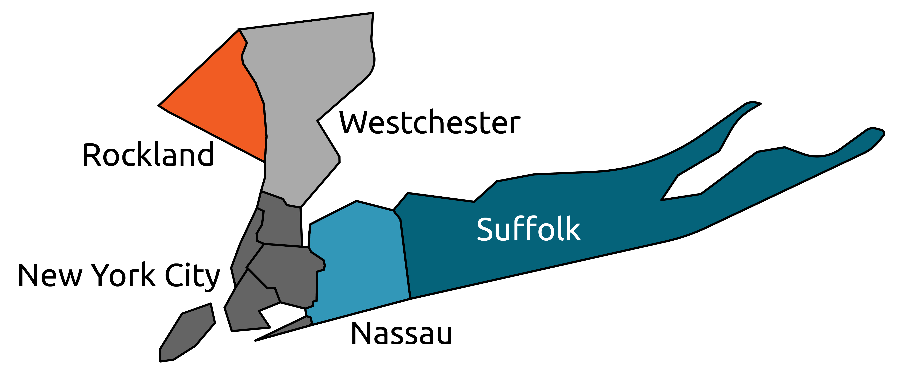


Partners Health Plan — Overview
In 2016, Partners Health Plan (PHP) was established to demonstrate the efficacy of integrated managed care for individuals with Intellectual and/or Developmental Disabilities (I/DD)
Contracted with Medicare and New York State Department of Health (Medicaid) through the FIDA-I/DD Demonstration
Designed specifically for individuals who are dually eligible for Medicare
and Medicaid
Served New York City, Nassau, Suffolk, Rockland and Westchester counties

Slide 3


WHAT MADE PHP UNIQUE
New York State’s only managed care plan dedicated exclusively to individuals with I/DD
Integrated:
  Medicare
  Medicaid
  OPWDD and I/DD services
Reduced fragmentation by aligning coverage, providers and care management under one plan
Backed by long-standing sponsor agencies:
  ARC Chapters
  ADAPT Community Network
Built on decades of experience serving people
with I/DD
A Singular Focus on the I/DD Community

Slide 4

Our Mission & Vision
Mission
Deliver fully-integrated, person-centered care planning that supports:
  Access to high-quality 1915(c) Waiver services, healthcare and other supports
  Health, wellness, and quality of life
  Each member’s ability to live the life they choose
Vision
Be a trusted partner and advocate for people with I/DD and their families
Support members in achieving life goals, improving health and participating fully in their communities

Slide 5
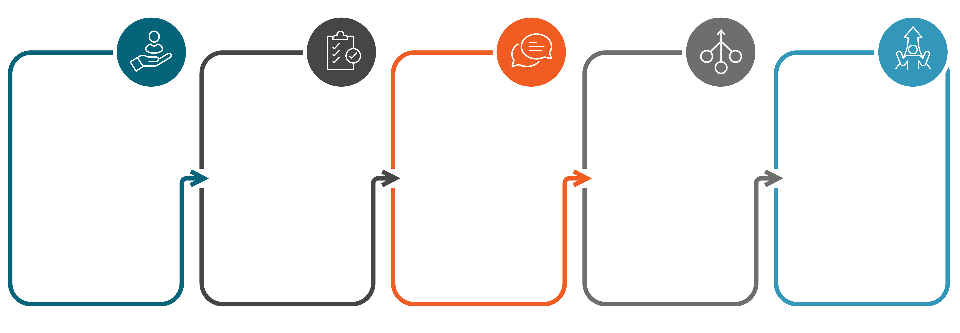
PHP’s Care Model
Strong
emphasis on:
  Care coordination and clinical needs
  Navigation of complex systems
  Family and caregiver engagement
Model prioritized choice, dignity and individual goals, in addition to clinical outcomes
Care Managers served as a consistent point of contact
Integrated medical, behavioral and long-term services and supports
Person-centered, interdisciplinary care teams with authority to approve services

Slide 6
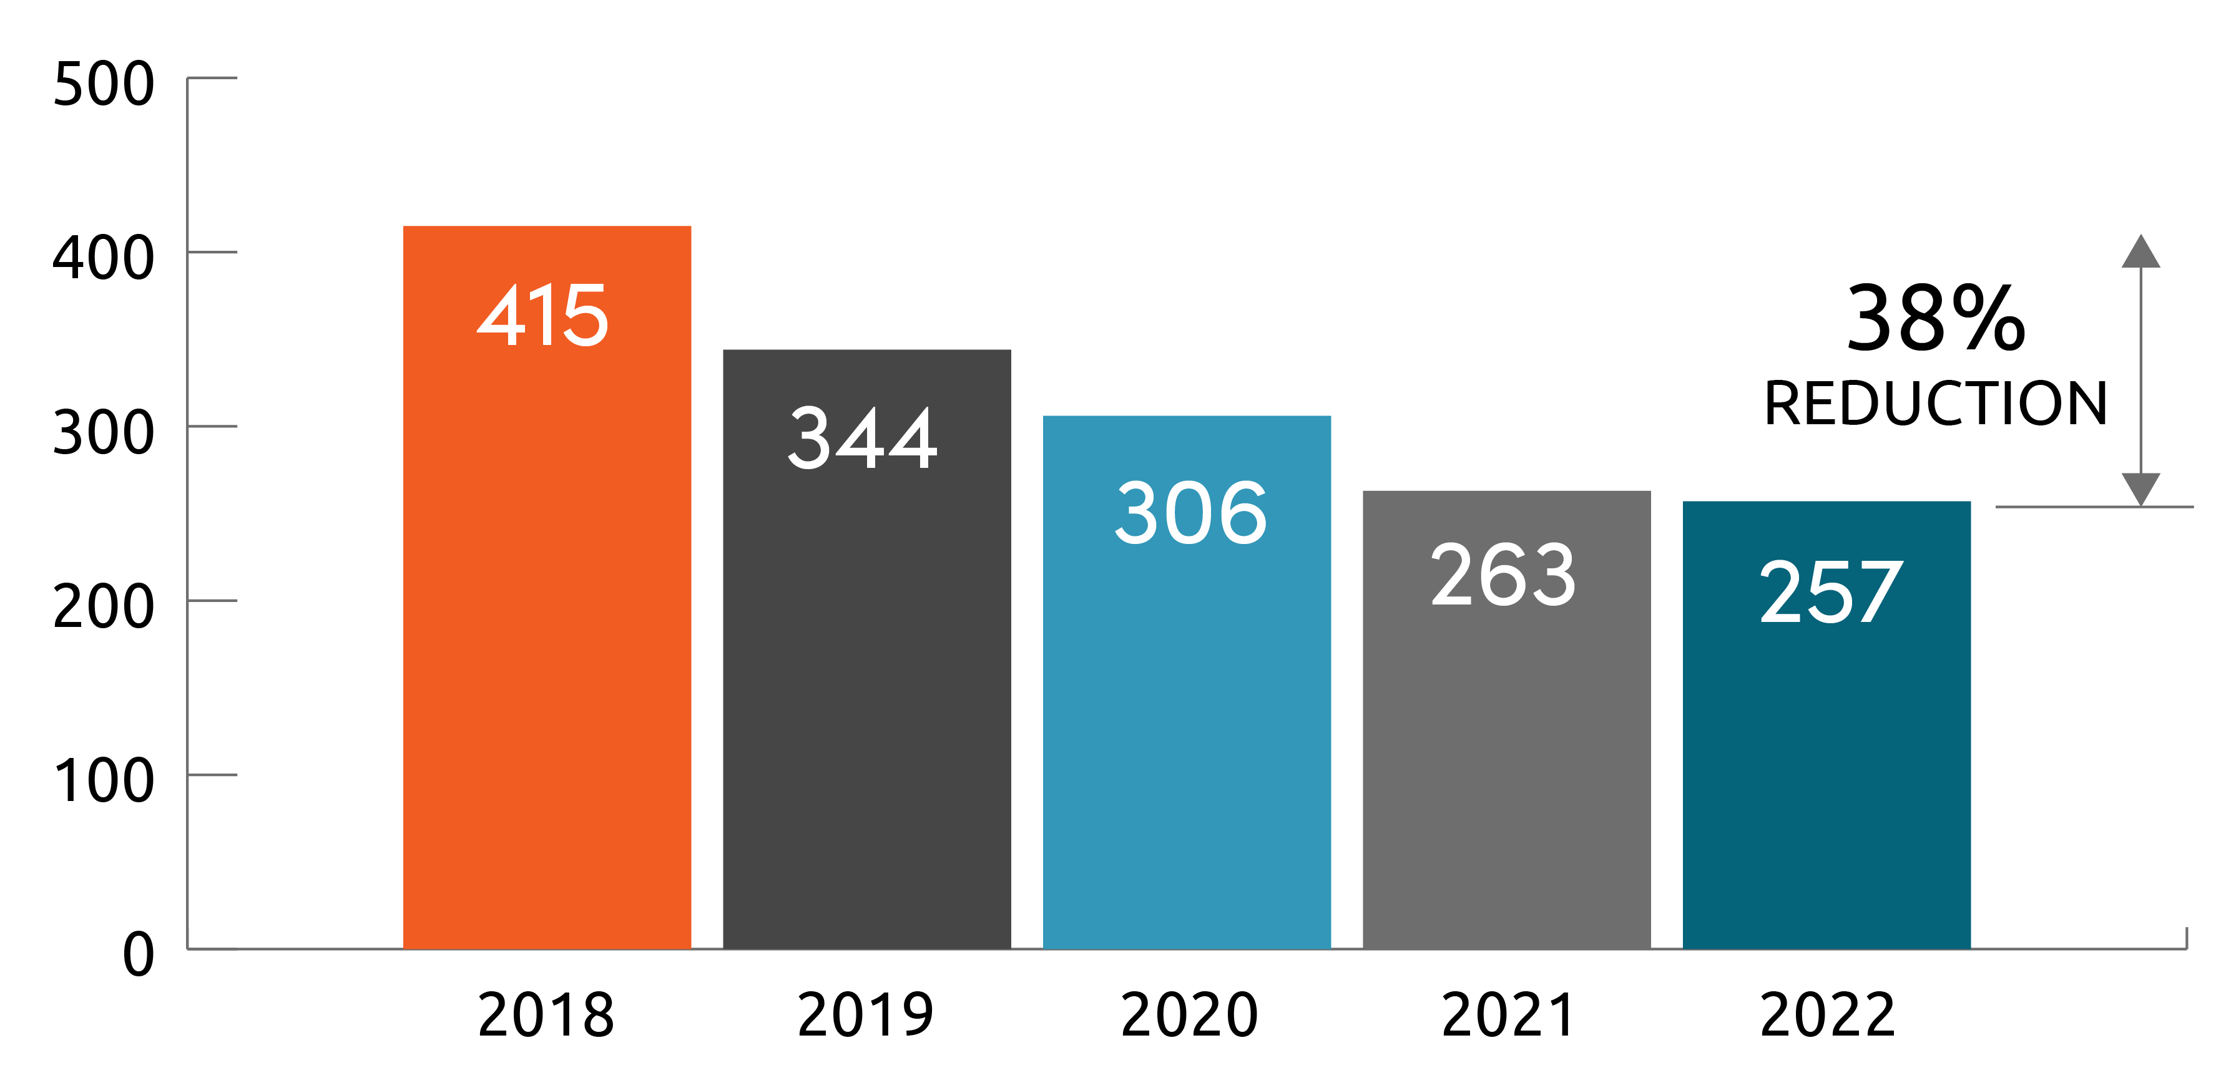
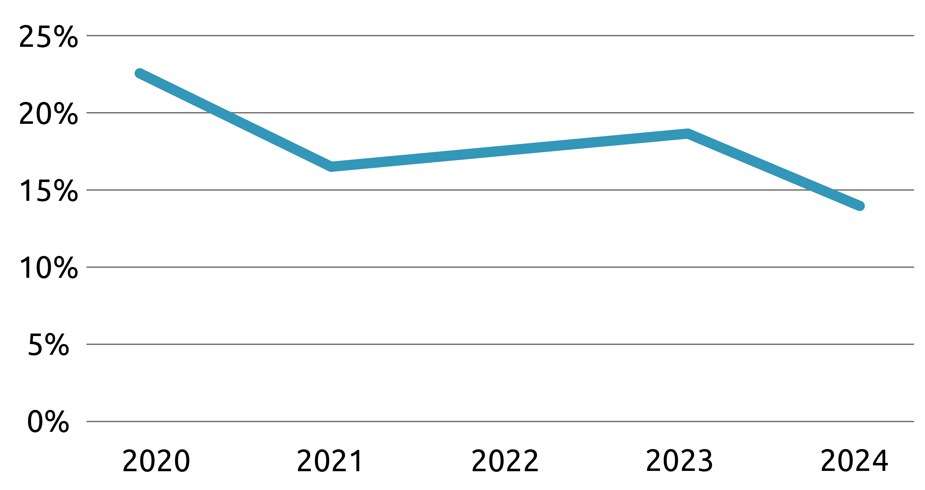
Results & Successes
IMPATIENT ADMISSIONS
What Worked Well
Demonstrated that fully-integrated care for individuals with I/DD can produce better access to healthcare and quality outcomes within a managed care framework
Improved coordination across traditionally siloed systems
Strong relationships with members, families and providers
High-touch care management model valued by members and caregivers
Established trust by centering the lived experience of individuals with I/DD
RE-ADMIT 30 DAY RATE

Slide 7
Results & Successes
Proven Impact in I/DD Care
By applying a combination of I/DD-specific care, clinical expertise and I/DD-tailored technology, we achieved measurable improvements in quality, outcomes, utilization and cost
High member and family satisfaction was evidenced through consistent survey results and very low member attrition
PHP’s integrated structure allowed rapid service adjustments during the COVID-19 public health emergency, including timely increases in PCA hours when day programs shut down, minimizing disruption for members and families
The plan’s ability to authorize short-term nursing supports in IRAs helped members return home safely after hospitalizations, supporting recovery in familiar, community-based settings

Slide 8
HEDIS Quality
Our experience with PHP demonstrated superior quality score compared to National averages.
Quality Measures | Year | National | Our Quality Score
Colorectal Cancer Screening | 2024 | 71% | 66%
Diabetes
-HbA1c Poor Control | 2024 | 19% | 16%
-HbA1C Control | 2024 | 72% | 81%
-Eye Exam | 2024 | 74% | 82%
-Controlling High Blood Pressure | 2024 | 74% | 87%
-Kidney Health Evaluation | 2024 | 53% | 31%
Annual Flu Vaccine | 2024 | 37% | 60%
Care for Older Adults Medication Review | 2024 | 75% | 97%
Breast Cancer Screening | 2024 | 71% | 66%
Controlling High BP | 2024 | 76% | 85%
All cause re-admission | 2024 | 1% | 0.87%

Slide 9

Challenges We Faced
System-Level Realities
Operating a one-of-a-kind federal demonstration created uncertainty for families and providers
Financial and operational constraints inherent in the demonstration structure
Changing landscape and policy decisions around managed care for I/DD services
Important Note: These challenges were structural, not a reflection of the value of fully-integrated, person-centered care.
9

Slide 10
FIDA-I/DD Demonstration Conclusion
Where We Are Today
The PHP FIDA-I/DD Demonstration officially concluded on December 31, 2025
While the demonstration ended, our responsibility to members, families, providers and teams continues
PHP implemented a structured, person-centered transition plan to support members through this change
Medicaid coverage remains unchanged, including OPWDD services and supports

Slide 11



What We Learned
Key Takeaways from PHP
Integrated care works best when it is designed around people, supported by systems
Strong interdisciplinary care coordination is essential for individuals with complex needs
Families and caregivers are critical partners in achieving meaningful outcomes
For fully integrated, I/DD-centered managed care to succeed, strong governmental policy support and fiscal alignment are required

Slide 12
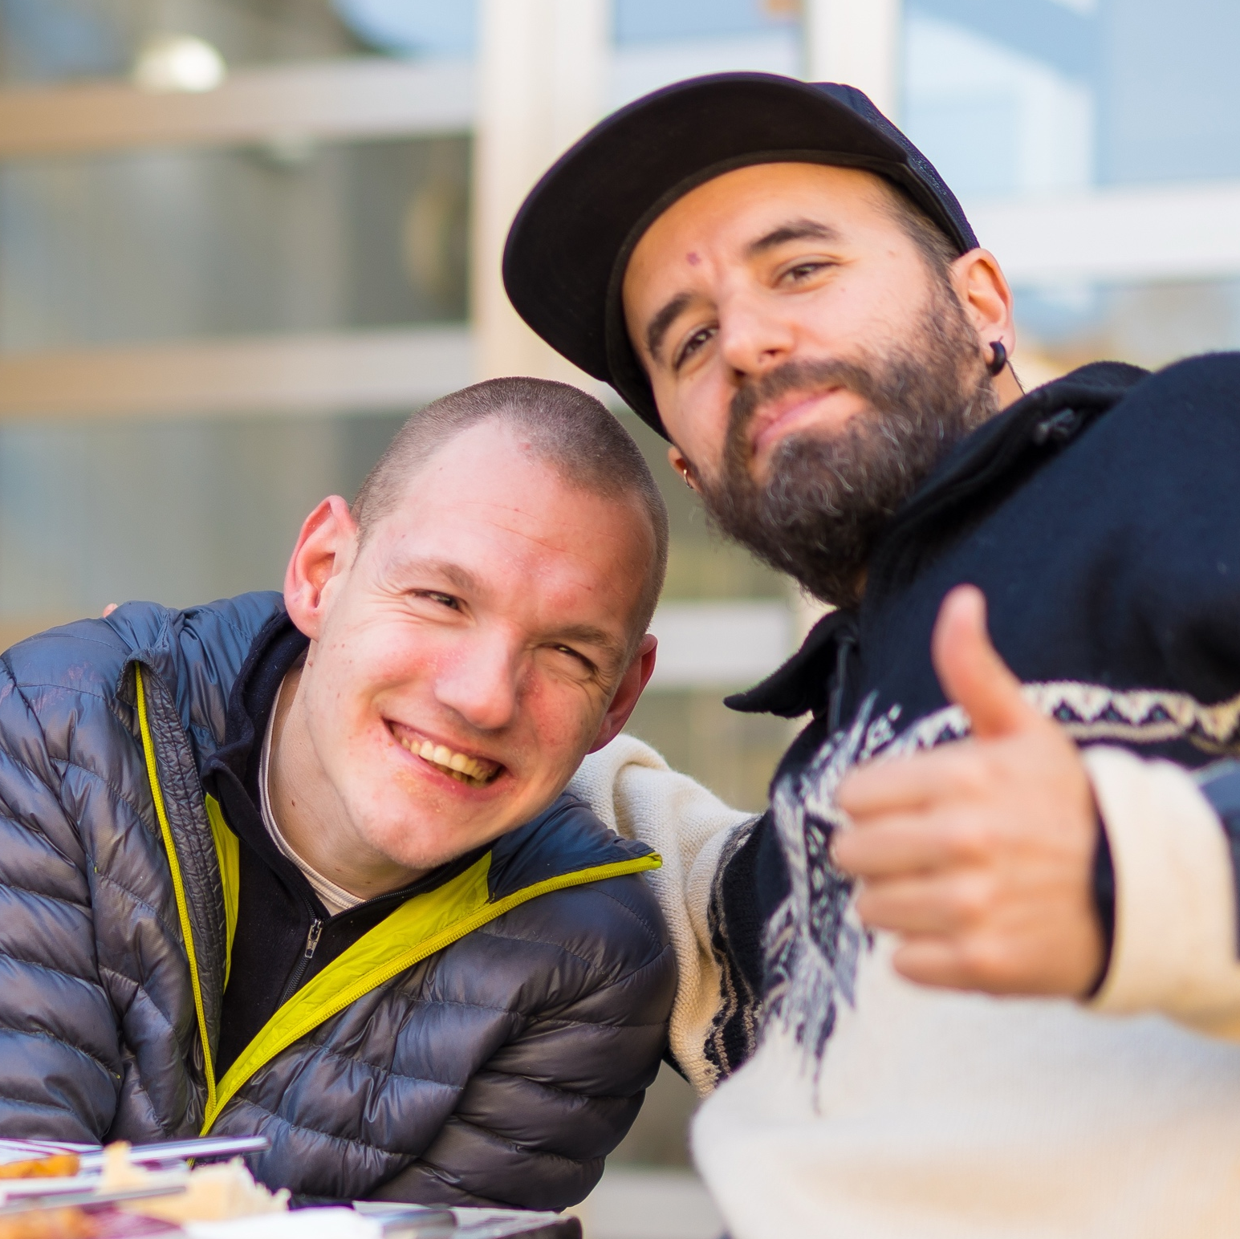



What We Carry Forward
Turning Experience Into Impact
A continued commitment to person-centered care planning
Ongoing focus on:
  Simplifying complex systems
  Supporting choice and autonomy
  Improving quality of life
Applying lessons learned about integration, coordination and advocacy and achieving better access to and quality of healthcare for members
Using PHP’s experience to inform future models, programs, and partnerships now in development

Slide 13

THANK YOU

